Slide 1
Second Class Sports Day
Friday 19th June 2020
(or a day over the weekend if more suitable)

Slide 2
Hello!
Second class are having a virtual sports day today! Challenge yourself to be the best athlete you can be. Will you be a gold, silver or bronze athlete?
It is also a competition between Ms McGuinness’ and Ms Smith’s Class to see which class will be the sports day champions!
Complete some or all of the listed activities at home. For every activity you complete you will be awarded a point for your class! Which second class will be the sports day champions?
Please take short videos/photos throughout the day and send to your class teacher along with your activity log at the end of the day! We would love to see how you got on!
For every task you complete, colour a star on the next page. If you complete 1 task, you are a Bronze Athlete. If you complete 2-7 tasks, you are a Silver Athlete. If you complete 8 or more tasks, you are a Gold Athlete. Certificates will be emailed out next week for participation.
Have fun!
Ms McGuinness and Ms Smith

Slide 3
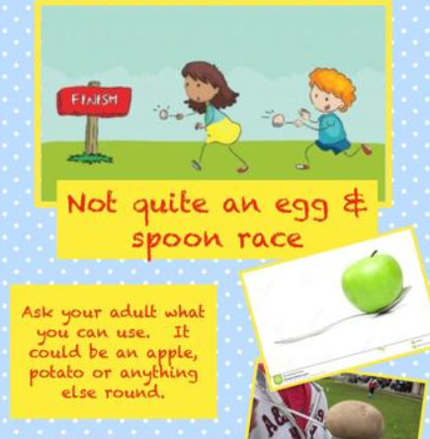
1. Spud and Spoon Race
Place a potato on a spoon and have a race with your parents/ siblings/ neighbour up and down your garden! First one over the finish line without dropping their spud is the winner!

Slide 4
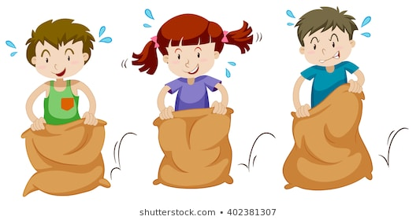
Sack Race
Climb into a sack/bin bag/ pillowcase and hop down the garden! First one to the finish line wins!

Slide 5
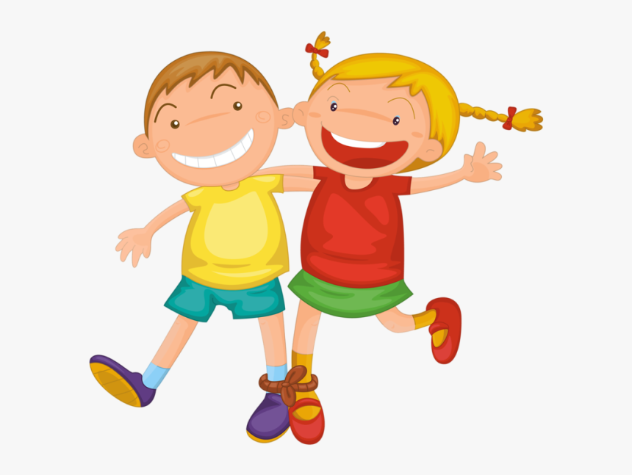
Three-Legged Race
With a partner, stand side by side and tie your inside legs together! Practise walking up and down the garden until you can run faster and faster!

Slide 6
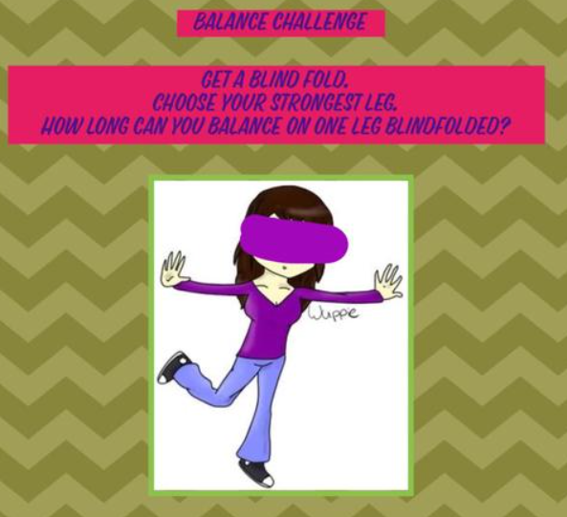
Balance Challenge
Get a Blindfold, put it on and stand on one leg. How long can you stand there for? Make sure to time yourself!

Slide 7
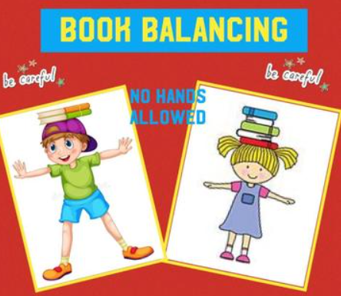
Book Balance
Place a book on your head and try to walk up and down the garden without dropping it! You can’t use your hands to help you! If you can do it with one book, can you do it with two or three?

Slide 8
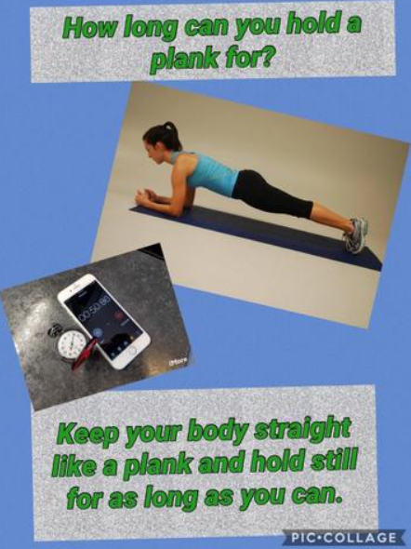
Plank Challenge
Forming the plank position, try and hold a plank for as long as possible! Time yourself!
There are lots of different variations of planks…
Can you do any of the tougher versions?

Slide 9
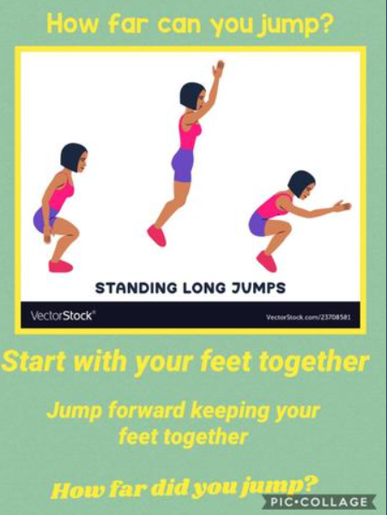
Bunny Hop Challenge
Starting in a squat position, jump as far forward in one hop as you can. Measure the distance between your start and finish point using a measuring tape or ruler!

Slide 10
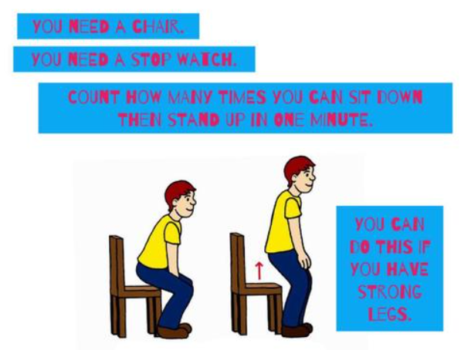
Chair Challenge
How many times can you sit down and stand up on a chair in a minute?

Slide 11
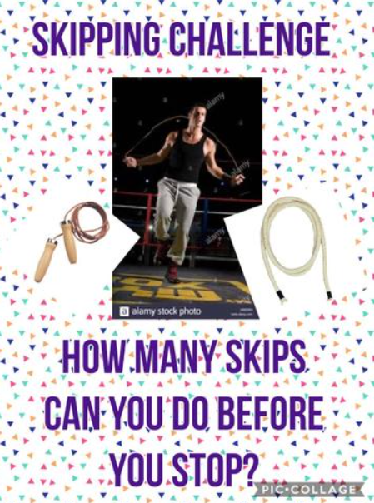
Skipping Rope Challenge
How long can you skip for before having to stop?

Slide 12
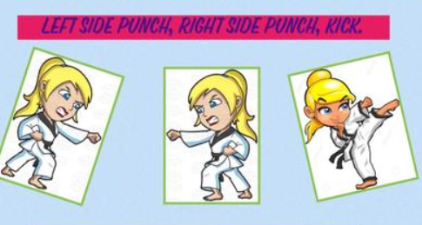
Ninja Challenge
Can you punch and kick to the music of Kung Fu Fighting? Left punch, right punch, left kick, right kick for the whole song!
https://www.youtube.com/watch?v=QspjKVTMlL8

Slide 13
Washing Line Challenge
How many items can you hang on the washing line in one minute? Every item of clothing needs to have at least two pegs holding it up!

Slide 14
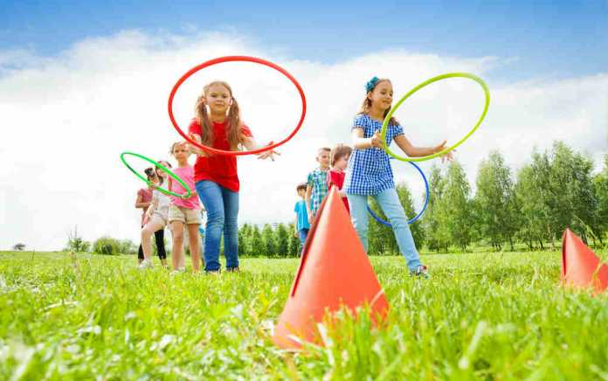
Obstacle Course Challenge
Design and Make an Obstacle Course in your garden/ living room with at least three obstacles. Then, run over it!

Slide 15
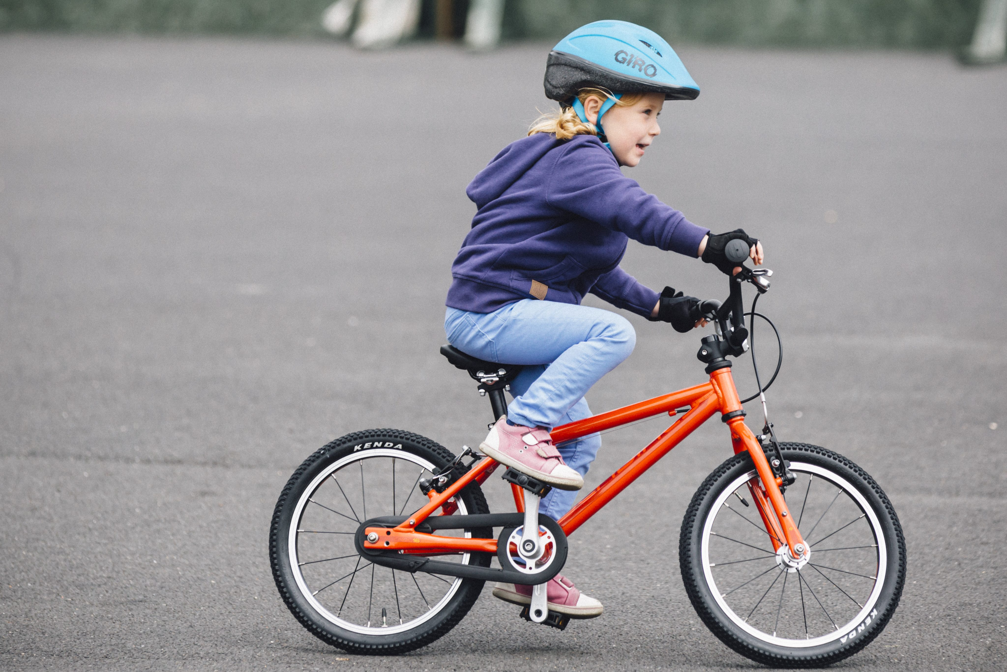
Cycle, Scoot, Flick, Skateboard or Rollerblade Challenge
Use whichever you have and cycle, scoot, flick, skate or rollerblade for at least five minutes.

Slide 16
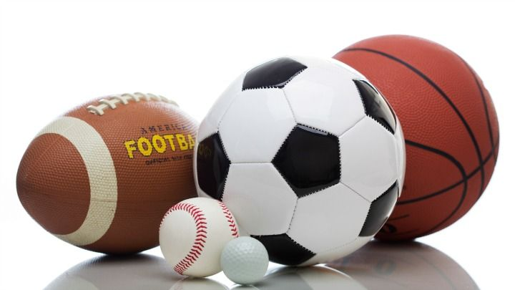
Play Ball
Play any game that involves a ball. It could be soccer, Gaelic football, basketball, tennis, rugby, rounders, Time Bomb, Donkey, bowling…

Slide 17
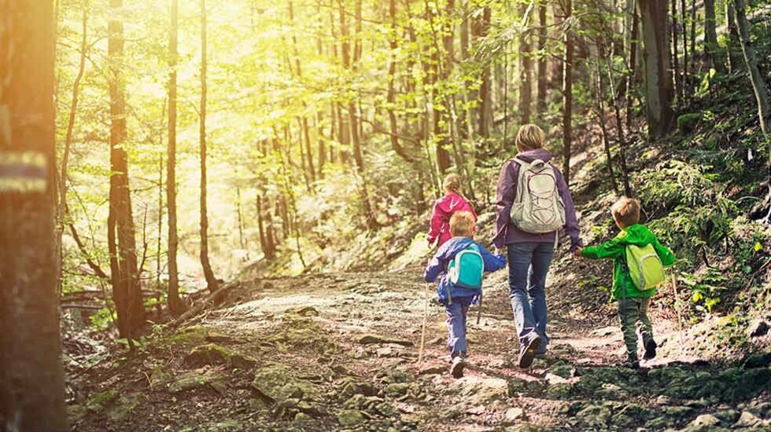
Family Walk
Go for a walk outdoors with your family! Wear costumes if you’d like for extra giggles.

Slide 18
Finally
Make sure to rest and rehydrate.
Fill in your sports day activity log and send to your teacher along with any photographs/ videos you’ve taken from the day!
Wait for your certificate to be sent out via email
We will announce which class were the sports day champions next week.
We hope you had lots of fun ☺

